Slide 1
Project 2: ETL Process – World Happiness Report
TEAM MEMBERS
Hayley Win
Tuflikha Putri
John Nasiakos
Hatim Mansor

Slide 2
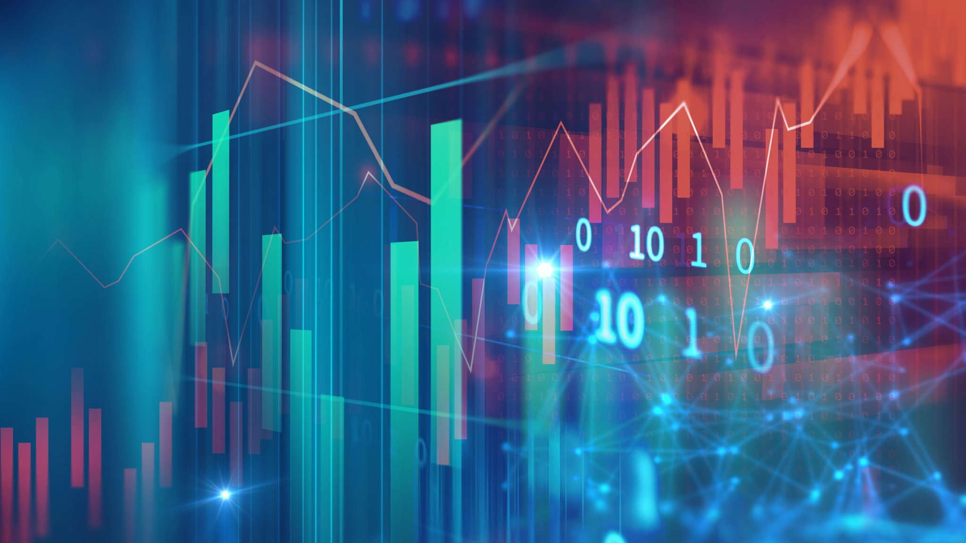
ETL - Process
Background Use Case
Extract:
Data Sources researched
Extraction and investigation
Transformation
Needs of Database explored
Cleansing of empty values
Removal of redundant columns
Schema Diagram
Load
Loading of curated data in to Databse
Future Proofing
Q&A

Slide 3
Background use case
The HR Department at Youtube have requested a reporting dashboard to track the results of the global happiness report established by the UN.
DB team now must build a stable database for the reporting dashboard to be able to pull data.
The interest in the data is primarily for promotional purposes but future use may include analysis of other global sized datasets (i.e UN Poverty Report)

Slide 4
EXTRACT
Happiness index dataset on Kaggle
Global Population dataset on Kaggle
Country ISO code list on Wikipedia
Data Structure
Establish country as key to connect the disparate data sets
Country ISO Chosen to future proof database for potential further global analysis.

Slide 5
Transform
Pandas to clean and format datasets;
Jupyter notebook for data exploration, clean up, and the final data analysis.
Use of Heatmap for visual display of data
Dropping null values for consistency
Drop redundant data columns in Happiness datasets
Removed Countries less than 50K pop and matched UN country code list.

Slide 6
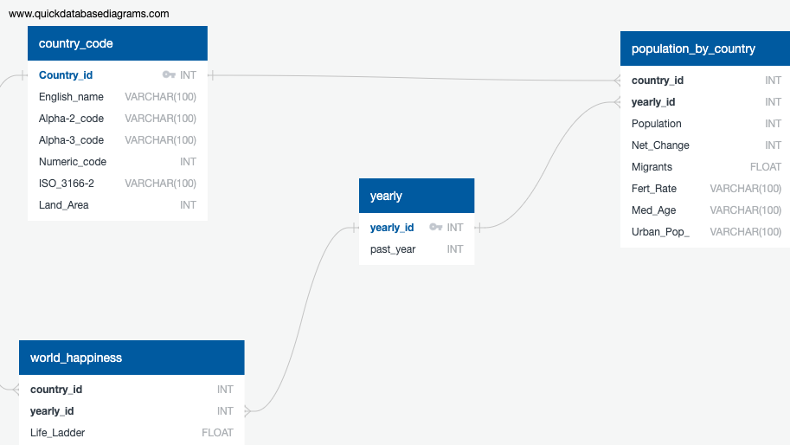
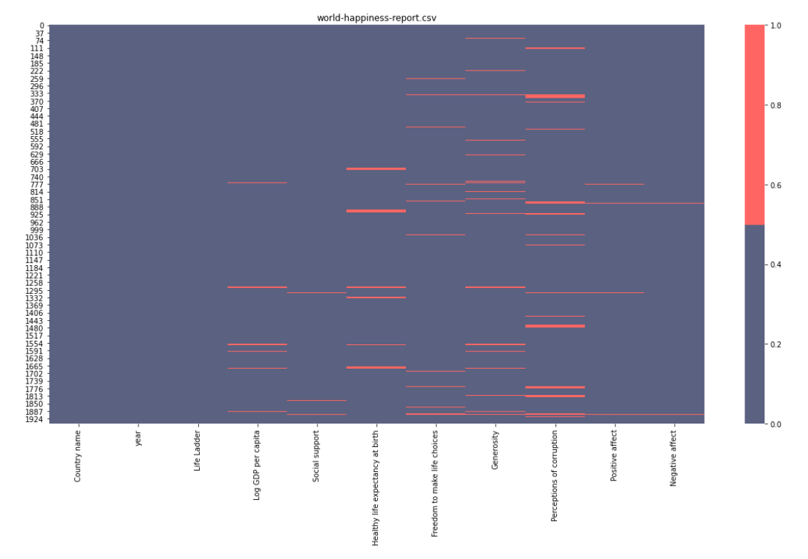
Data engineering – SCHEMA DIAGRAM & Validation

Slide 7
Load
As part of normalisation a yearly calander has been added as a reference table.
Country used as Primary Key between data tables
The use case dictates that this DB will expand

Slide 8
Q&A

